Slide 1

Node.JS
“Everything that can be written in JavaScript will eventually be written in JavaScript”. (Atwood’s law)

Slide 2
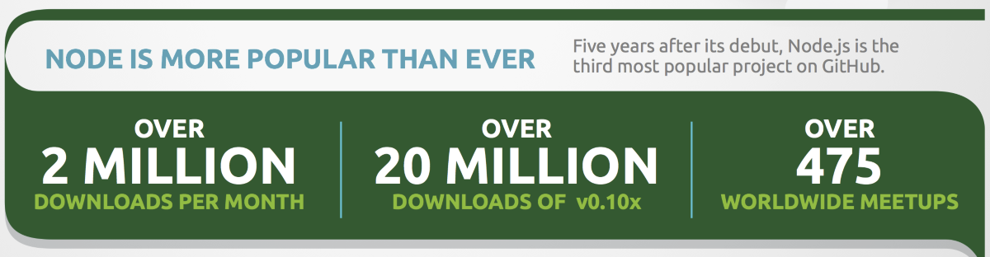
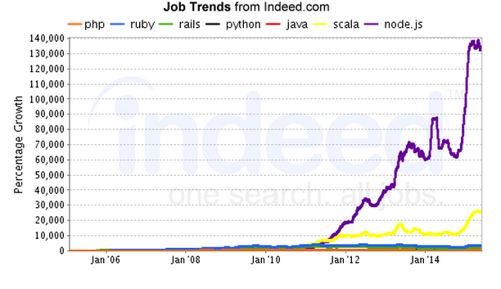
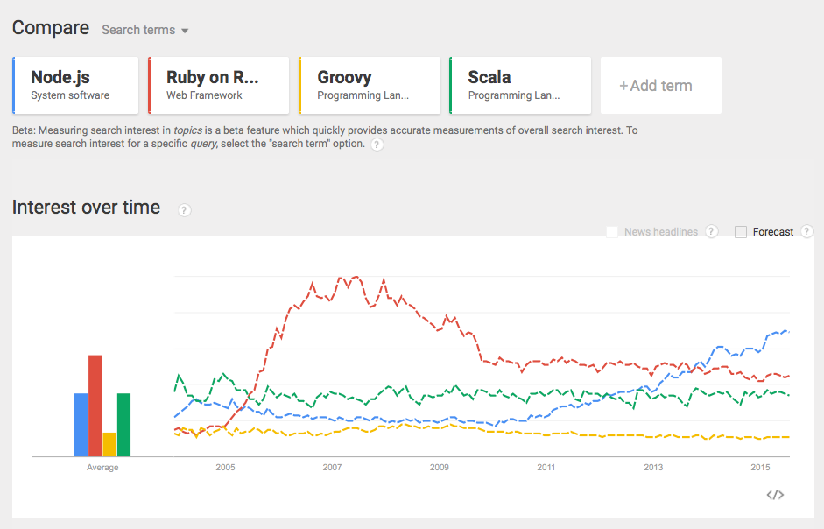
Node Has Arrived

Slide 3

NODE IS USED BY BIG BRANDS

Slide 4
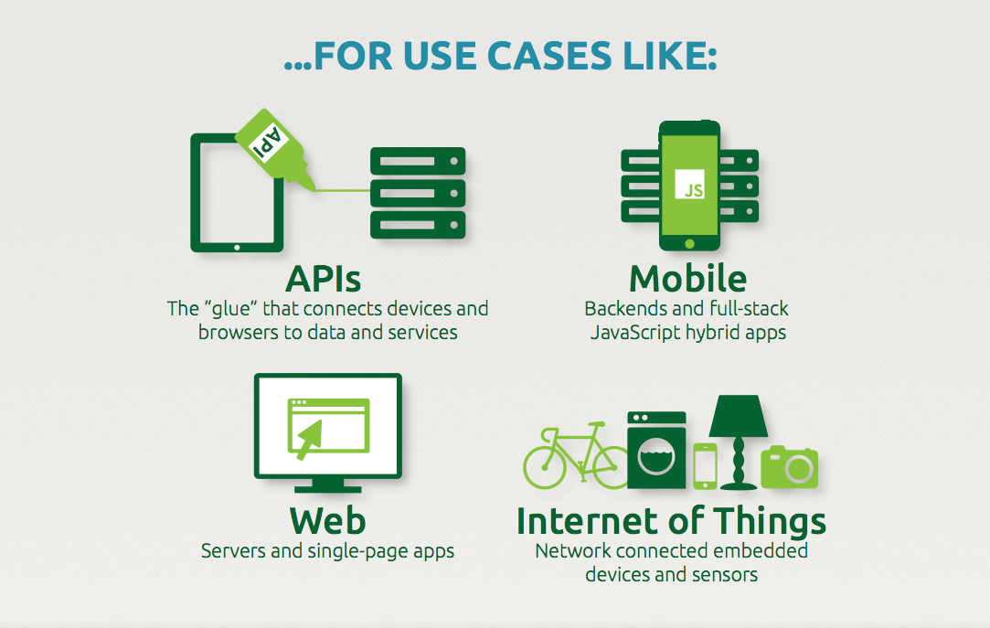

Slide 5
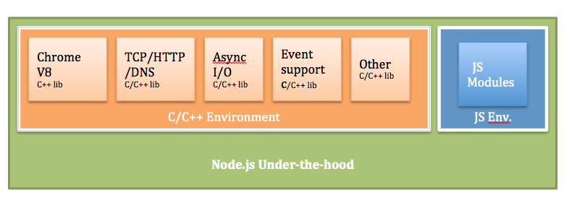
Node.js Building Blocks
A high performance, cross-platform evented I/O library
libuv
V8
Js, C++
Node.js
Google JavaScript Engine

Slide 6
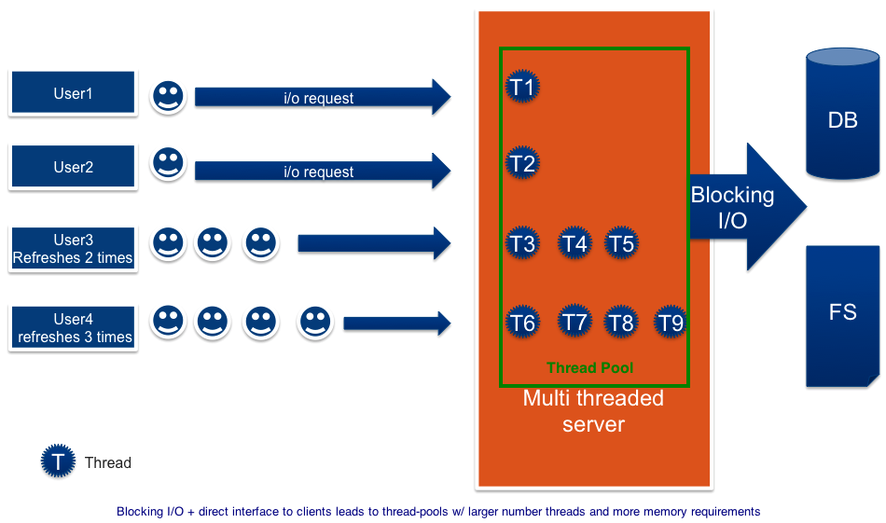
Multi-threaded HTTP Server Using Blocking I/O

Slide 7
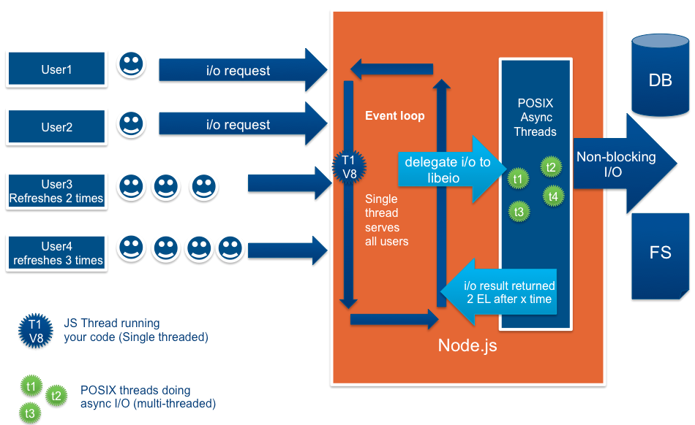
Event-driven, Non-Blocking I/O
(source: Future-proofing Your Apps: Cloud Foundry and Node.js)

Slide 8
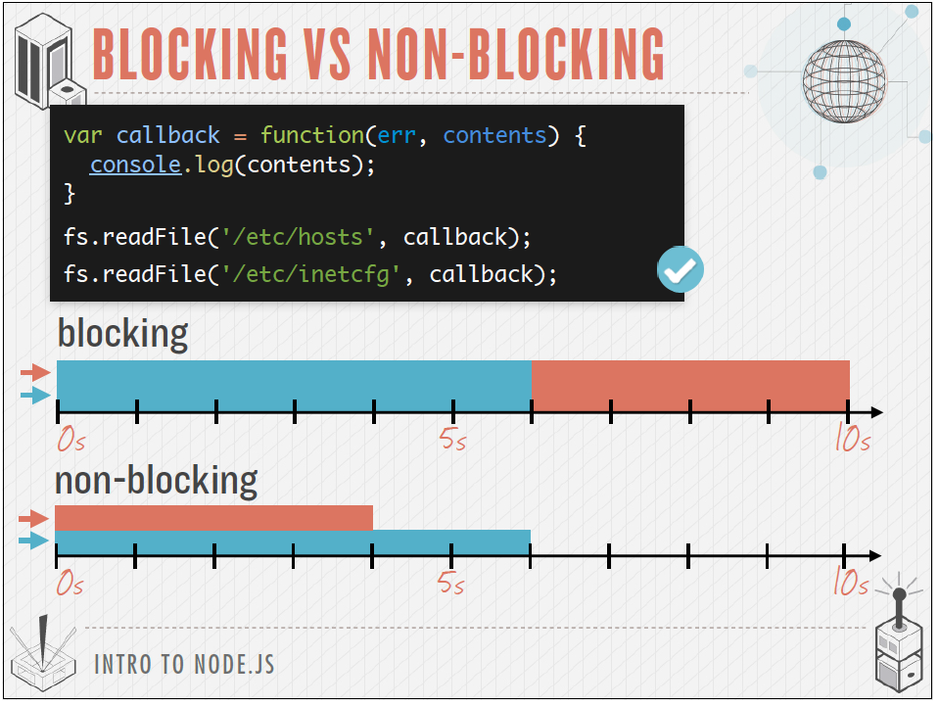

Slide 9
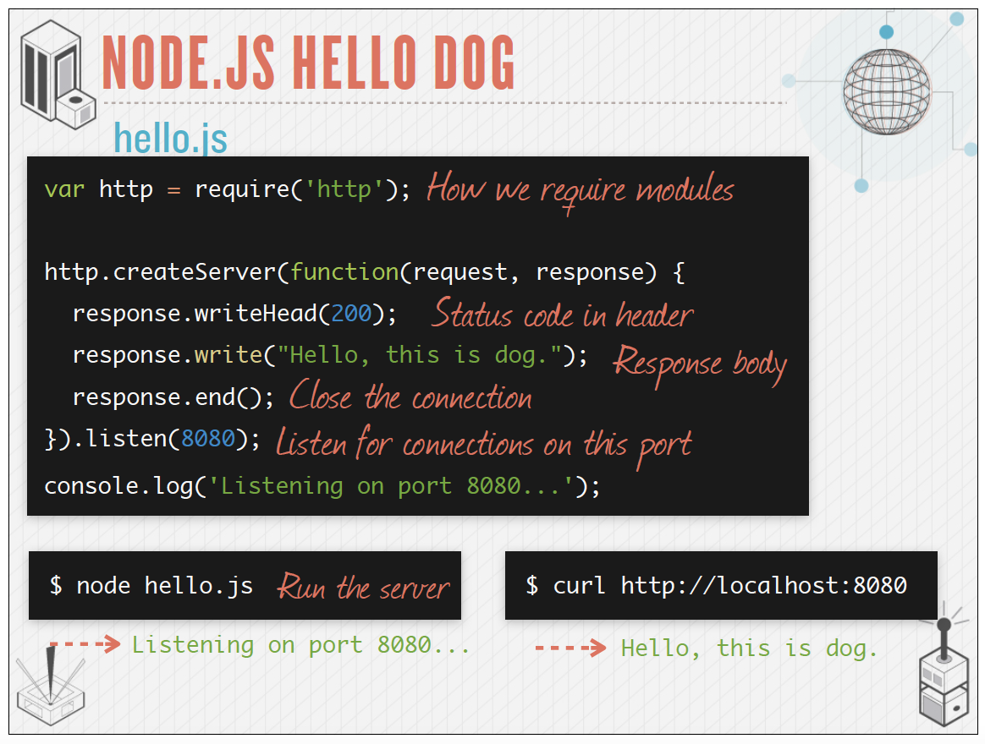

Slide 10
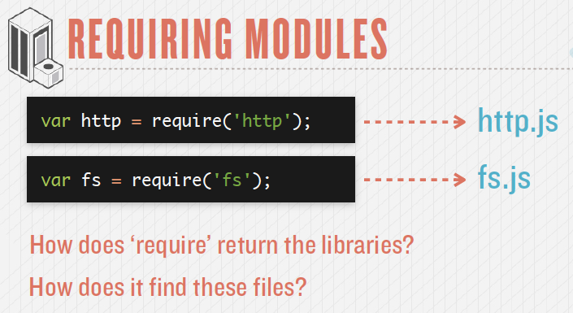
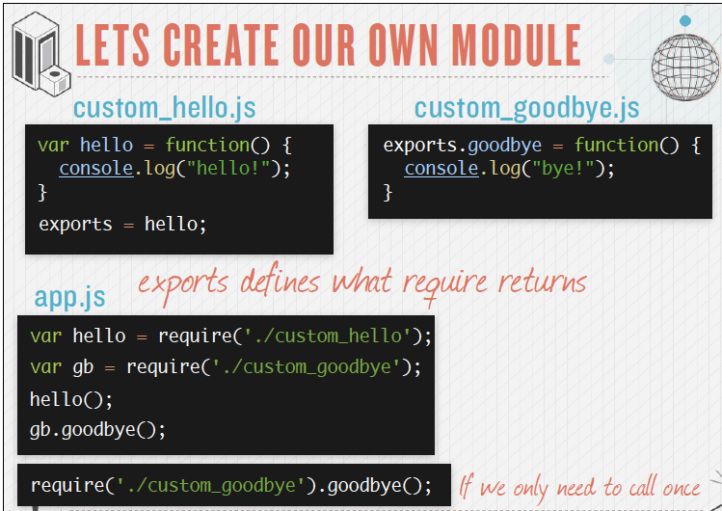
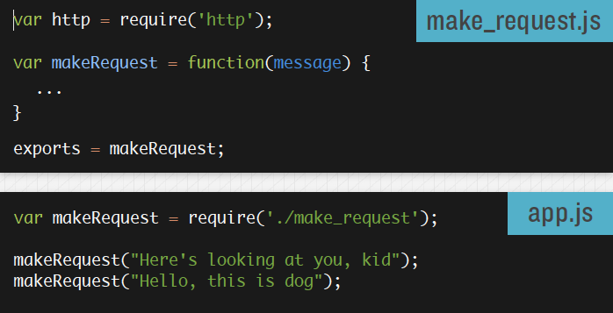
Modules

Slide 11

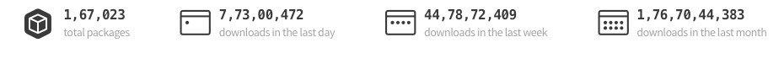
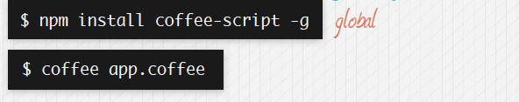
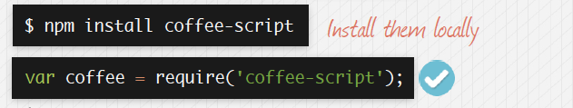
Node Package Manager
Package manager for node
• Comes with node
• Module Repository
• Dependency Management
• Easily publish modules
• “Local Only”
“Core” is small. “Userland” is large.
Global
Locally

Slide 12
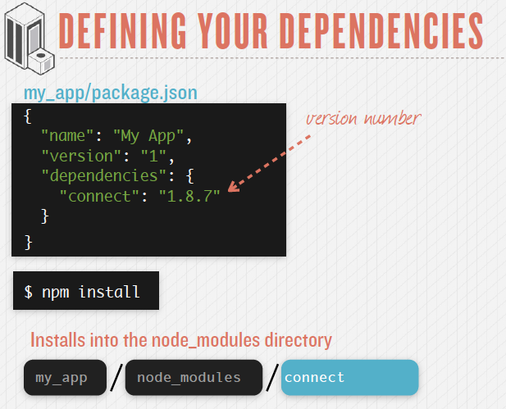

Slide 13
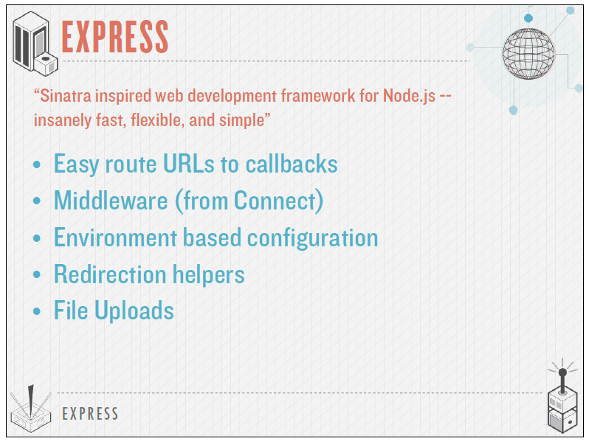

Slide 14
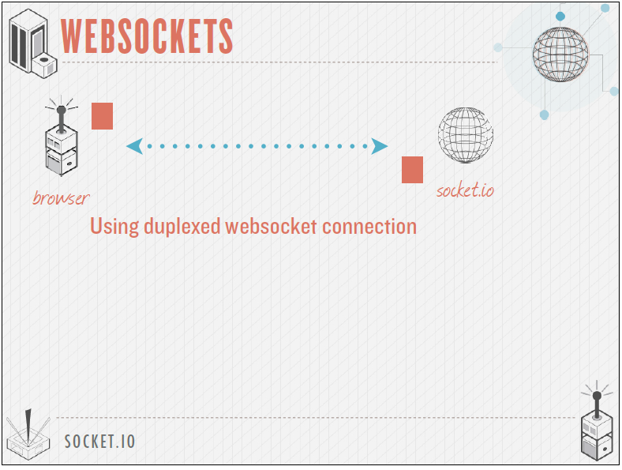

Slide 15
Pay Pal The benefits from NodeJS migration:
Full-stack engineers. Using JavaScript on both the front-end and the back-end removed an artificial boundary between the browser and server, allowing engineers to code both.
Built almost twice as fast with fewer people
Written in 33% fewer lines of code
Constructed with 40% fewer files
Double the requests per second vs. the Java application.
35% decrease in the average response time for the same page.
LinkedIn from NodeJS
Much better performance and lower memory overhead than other tested options, running up to 20x faster in some scenarios
Programmers could leverage their JavaScript skills.
Frontend and backend mobile teams could be combined into a single unit.
Servers were cut to 3 from 30. Enough headroom remains to handle 10x current levels of resource utilization.
Development could focus more on application development than firefighting

